Slide 1

CORRELATION
ML LABS PVT LTD || WWW.ANALYTICS6.COM || DATA SCIENCE , AI , ML ,COMPUTER VISION || TRAINING AND CONSULTING
Phone Number : 91-6362546088 || Email : contact@analytics6.com

Slide 2
What is correlation?
Correlation is a statistical measure that helps to analyze the degree of relationship between two variables.
The measure is best used in variables that demonstrate a linear relationship between each other.
The fit of the data can be visually represented in a scatterplot.
Using a scatterplot, we can generally assess the relationship between the variables and determine whether they are correlated or not.
ML LABS PVT LTD || WWW.ANALYTICS6.COM || DATA SCIENCE , AI , ML ,COMPUTER VISION || TRAINING AND CONSULTING
Phone Number : 91-6362546088 || Email : contact@analytics6.com

Slide 3
correlation coefficient: The correlation coefficient is a value that indicates the strength of the relationship between variables. The coefficient can take any values from -1 to 1.
Correlation
Positive correlation
Negative correlation
ML LABS PVT LTD || WWW.ANALYTICS6.COM || DATA SCIENCE , AI , ML ,COMPUTER VISION || TRAINING AND CONSULTING
Phone Number : 91-6362546088 || Email : contact@analytics6.com

Slide 4
Types of correlation:
The interpretations of the values are:
-1: Perfect negative correlation. The variables tend to move in opposite directions. when one variable increases, the other variable decreases. (Eg :A student who has many absences has a decrease in grades.)
0: No correlation. The variables do not have a relationship with each other.
1: Perfect positive correlation. The variables tend to move in the same direction when one variable increases, the other variable also increases. (Eg :The more time you spend running on a treadmill, the more calories you will burn)
ML LABS PVT LTD || WWW.ANALYTICS6.COM || DATA SCIENCE , AI , ML ,COMPUTER VISION || TRAINING AND CONSULTING
Phone Number : 91-6362546088 || Email : contact@analytics6.com

Slide 5
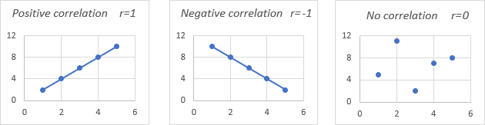
Correlation diagram
ML LABS PVT LTD || WWW.ANALYTICS6.COM || DATA SCIENCE , AI , ML ,COMPUTER VISION || TRAINING AND CONSULTING
Phone Number : 91-6362546088 || Email : contact@analytics6.com

Slide 6
Pearson’s Coefficient of Correlation:
It is widely used mathematical method.
The numerical expression was used to calculate the degree and direction of the relationship between linear related variables.
Pearson’s method popularly known as a Pearsonian Coefficient of Correlation, is the most extensively used quantitative methods in practice. The coefficient of correlation is denoted by “r”.
ML LABS PVT LTD || WWW.ANALYTICS6.COM || DATA SCIENCE , AI , ML ,COMPUTER VISION || TRAINING AND CONSULTING
Phone Number : 91-6362546088 || Email : contact@analytics6.com

Slide 7
Pearson’s Coefficient of Correlation:
Pearson's r can range from −1 to 1. An r of −1 indicates a perfect negative linear relationship between variables, an r of 0 indicates no linear relationship between variables, and an r of 1 indicates a perfect positive linear relationship between variables.
ML LABS PVT LTD || WWW.ANALYTICS6.COM || DATA SCIENCE , AI , ML ,COMPUTER VISION || TRAINING AND CONSULTING
Phone Number : 91-6362546088 || Email : contact@analytics6.com

Slide 8
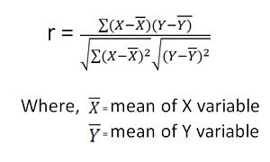
Pearson’s Coefficient formula:
The relationship between two variables X and Y is to be ascertained, then the following formula is used:
ML LABS PVT LTD || WWW.ANALYTICS6.COM || DATA SCIENCE , AI , ML ,COMPUTER VISION || TRAINING AND CONSULTING
Phone Number : 91-6362546088 || Email : contact@analytics6.com

Slide 9
Pearson’s Coefficient of Correlation
Example
In this example with the help of the following details in the table of the 6 people having a different age and different weights given below for the calculation of the value of the Pearson R
Sr No | Age (x) | Weight (y)
1 | 40 | 78
2 | 21 | 70
3 | 25 | 60
4 | 31 | 55
5 | 38 | 80
6 | 47 | 66

Slide 10
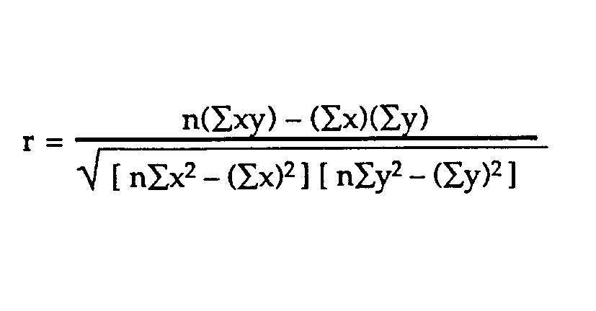
Solution:
For the Calculation of the Pearson Correlation Coefficient, we will first calculate the following values,
Sr No | Age (x) | Weight (y) | XY | x² | y²
1 | 40 | 78 | 3120 | 1600 | 6084
2 | 21 | 70 | 1470 | 441 | 4900
3 | 25 | 60 | 1500 | 625 | 3600
4 | 31 | 55 | 1705 | 961 | 3025
5 | 38 | 80 | 3040 | 1444 | 6400
6 | 47 | 66 | 3102 | 2209 | 4356
Total(∑) | 202 | 409 | 13937 | 7280 | 28365

Slide 11
r = (6 * (13937)- (202)(409)) / (√ [6 *7280 -(202)²] * [6 * 28365- (409)² )
r = (6 * (13937)- (202) * (409))/(√ [6 *7280 -(202)²] * [6 * 28365- (409)² )
r = (83622- 82618)/(√ [43680 -40804] * [170190- 167281 )
r = 1004/(√ [2876] * [2909 )
r = 1004 / (√ 8366284)
r = 1004 / 2892.452938
r = 0.35
Thus the value of the Pearson correlation coefficient is 0.35

Slide 12
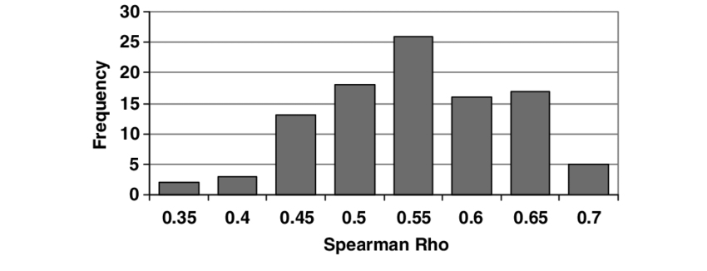
Spearman’s Rank Correlation Coefficient
It is the non-parametric statistical measure used to study the strength of association between the two ranked variables.
This method is applied to the ordinal set of numbers, which can be arranged in order, (i.e. one after the other so that ranks can be given to each).

Slide 13
Spearman Rank Correlation
The advantage of the Spearman Rank Correlation methods:
It give us the strength and direction of the monotonic relation between the connected variables.
This can be a good starting point for further evaluation.
Note: This method is applied only when the initial data are in the form of ranks, and N (number of observations) is fairly small, i.e. not greater than 25 or 30.

Slide 14
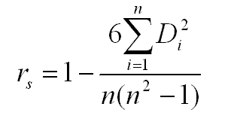
Spearman’s Rank Correlation Coefficient formula:
The formula to calculate the spearman’s rank correlation coefficient is:
Where, R = spearman’s Rank coefficient of correlation D = Difference of ranks N = Number of Observations

Slide 15
Solved Examples On Spearman Rank Correlation
The following table provides data about the percentage of students who have free university meals and their CGPA scores. Calculate the Spearman’s Rank Correlation between the two and interpret the result.
State University | % of students having free meals | % of students scoring above 8.5 CGPA
Pune | 14.4 | 54
Chennai | 7.2 | 64
Delhi | 27.5 | 44
Kanpur | 33.8 | 32
Ahmedabad | 38.0 | 37
Indore | 15.9 | 68
Guwahati | 4.9 | 62

Slide 16
Solution:
Let us first assign the random variables to the required data –
X – % of students having free meals Y – % of students scoring above 8.5 CGPA
Before proceeding with the calculation, we’ll need to assign ranks to the data corresponding to each state university.

Slide 17
State University | d_{X} = Ranks_{X} | d_{Y} = Ranks_{Y} | d = (d_{X} – d_{Y}) | d²
Pune | 3 | 4 | -1 | 1
Chennai | 2 | 6 | -4 | 16
Delhi | 5 | 3 | 2 | 4
Kanpur | 6 | 1 | 5 | 25
Ahmedabad | 7 | 2 | 5 | 25
Indore | 4 | 7 | -3 | 9
Guwahati | 1 | 5 | -4 | 16
 |  |  |  | Σd² = 96

Slide 18
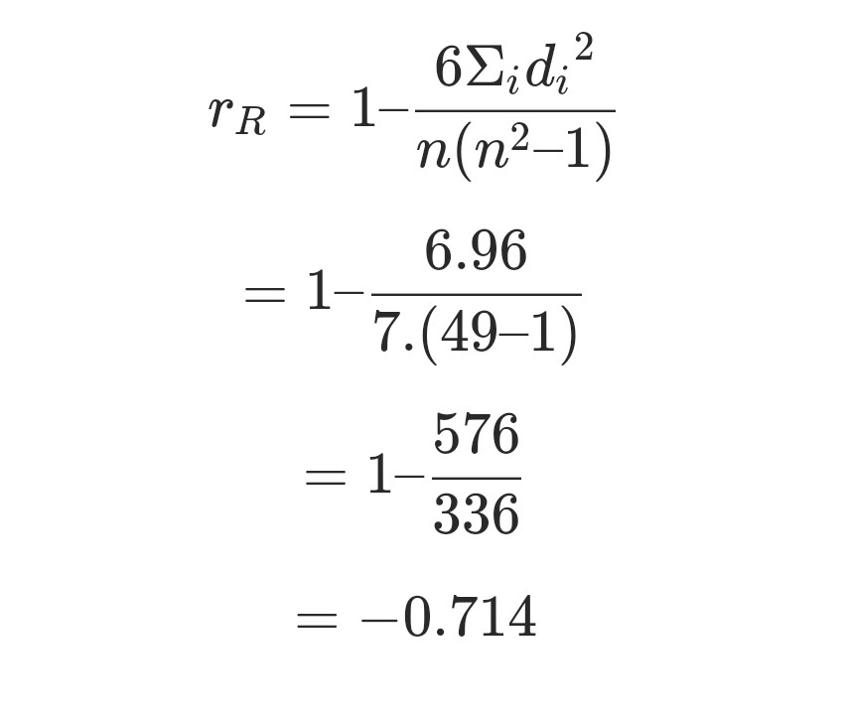
Now, using the formula with n = 7
Such a strong negative coefficient of correlation gives away an important implication – the universities with the highest percentage of students consuming free meals tend to have the least successful results

Slide 19
A comparison of the Pearson and Spearman correlation methods
Pearson correlation
Spearman correlation
The Pearson correlation evaluates the linear relationship between two continuous variables.
A relationship is linear when a change in one variable is associated with a proportional change in the other variable.
For example, you might use a Pearson correlation to evaluate whether increases in temperature at your production facility are associated with decreasing thickness of your chocolate coating.
The Spearman correlation evaluates the monotonic relationship between two continuous or ordinal variables.
In a monotonic relationship, the variables tend to change together, but not necessarily at a constant rate.
For example, you might use a Spearman correlation to evaluate whether the order in which employees complete a test exercise is related to the number of months they have been employed.

Slide 20

Thank you

